Slide 1
Robust Nonrigid Registration by Convex Optimization
Qifeng Chen
Stanford University
Vladlen Koltun
Intel Labs

Slide 2
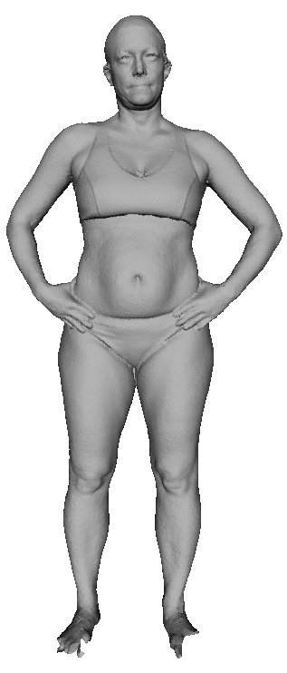
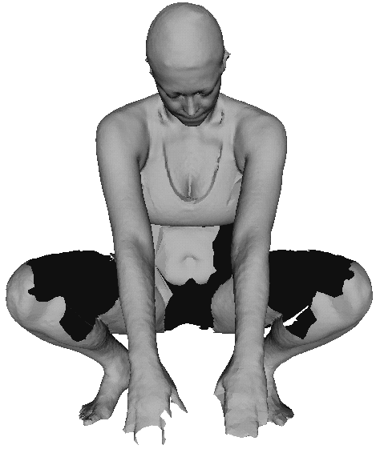
Nonrigid Registration
Intra-subject registration

Slide 3
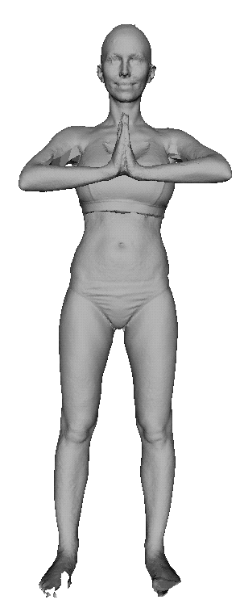
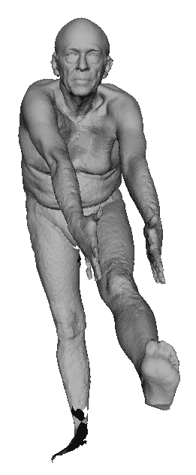
Nonrigid Registration
Inter-subject registration

Slide 4
Uses of Nonrigid Registration
Loop closure in dynamic reconstruction
Shape analysis
Propagation of material properties across 3D models
Surface completion

Slide 5
Prior work
Intrinsic descriptors
  Heat kernel signature [Sun et al. 2009]
  Wave kernel signature [Aubry et al. 2011]
  Global point signature [Rustamov 2007]
  Spectral descriptors [Litman et al. 2014]
  Optimal descriptors [Windheuser et al. 2014]

Slide 6


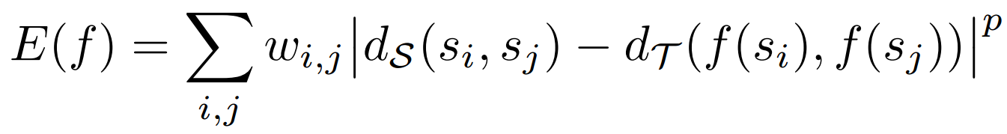

Prior work
Generalized multidimensional scaling (GMDS) [Bronstein et al. 2006]
  Given two surfaces
  Compute mapping
  Minimize highly nonconvex objective
  Optimize by gradient descent
  Easily stuck at bad local minima
(GMDS)

Slide 7






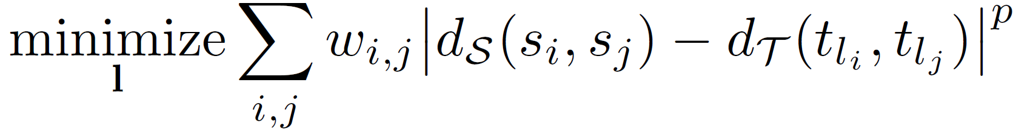
Optimization
Let and be points densely sampled over and
Optimize labeling ( is a set of m labels)
(GMDS)
Continuous Markov random field (MRF)
(Discrete MRF)

Slide 8
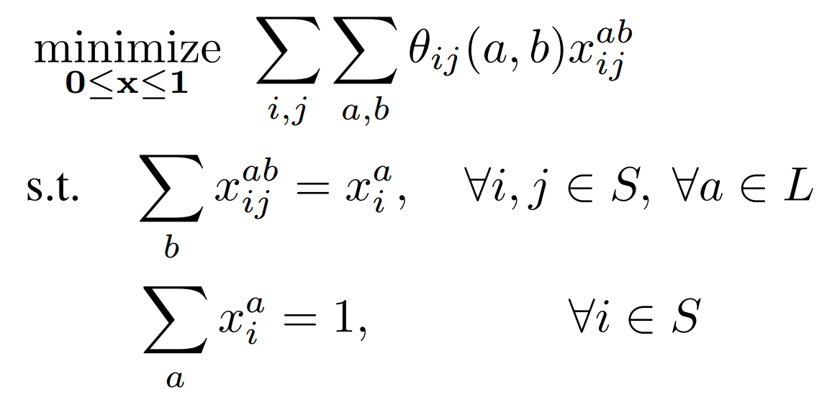
Optimization
(Discrete MRF)
(Linear program)
where

Slide 9
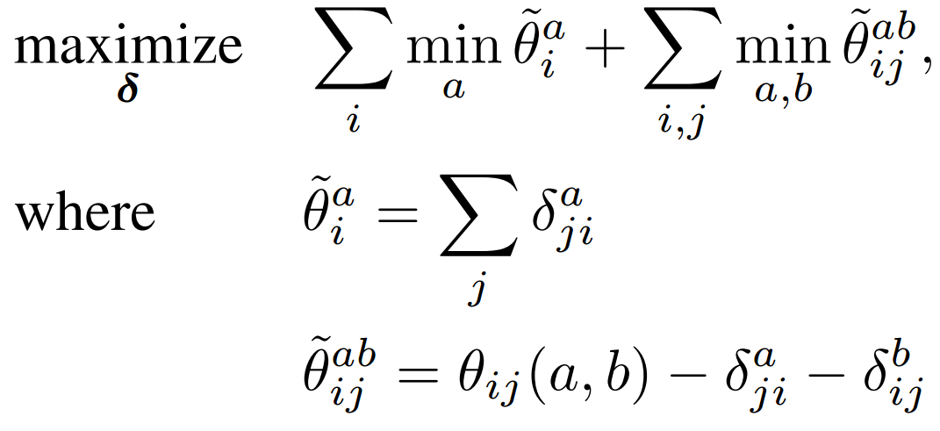
Optimization
(Linear program)
(Dual LP)

Slide 10
Optimization
(Linear program)
(Dual LP)
TRW-S [Kolmogorov 2006]

Slide 11
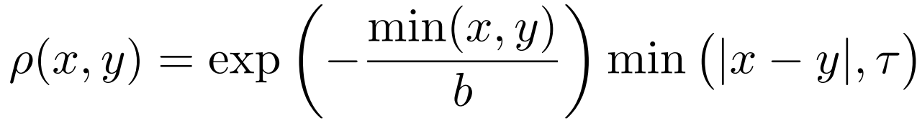
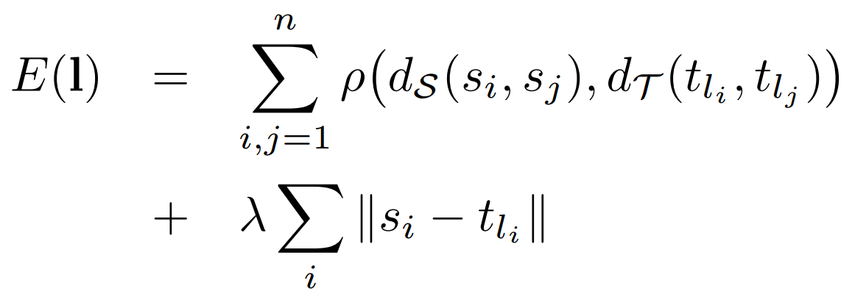
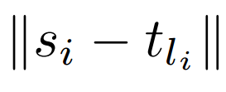
Objective
Penalty
Objective
where disambiguates intrinsic symmetry

Slide 12
Implementation
Preprocessing
  Poisson reconstruction for geodesic distance
  farthest point sampling
Global optimization
  sample hundreds of points
  random permutation of the nodes for best solution
Upsampling and refinement (optional)
  upsample mapping to thousands of correspondences
  refine the correspondences by fusion moves

Slide 13
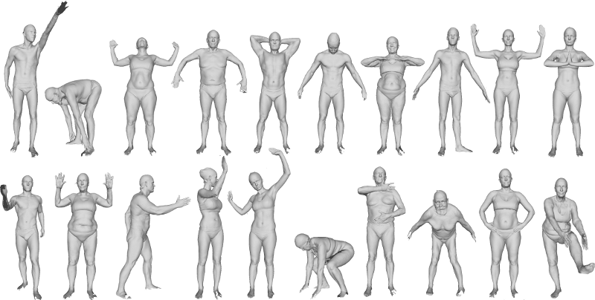
FAUST Dataset
FAUST [Bogo et al. 2014]

Slide 14
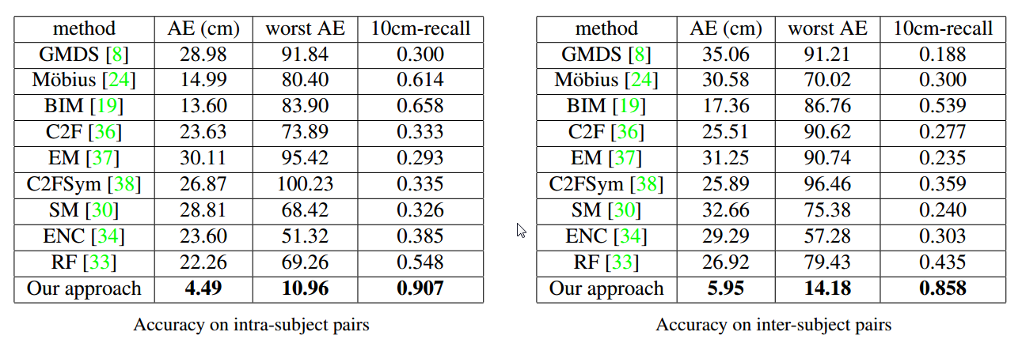
Results
Our approach outperforms a large body of prior work by a factor of 3

Slide 15
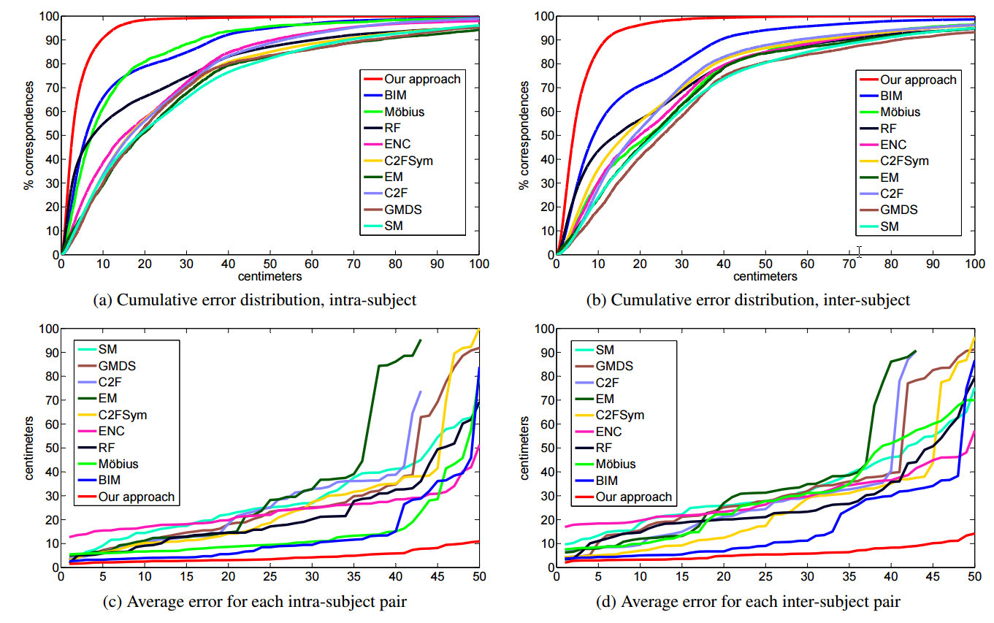
Results

Slide 16
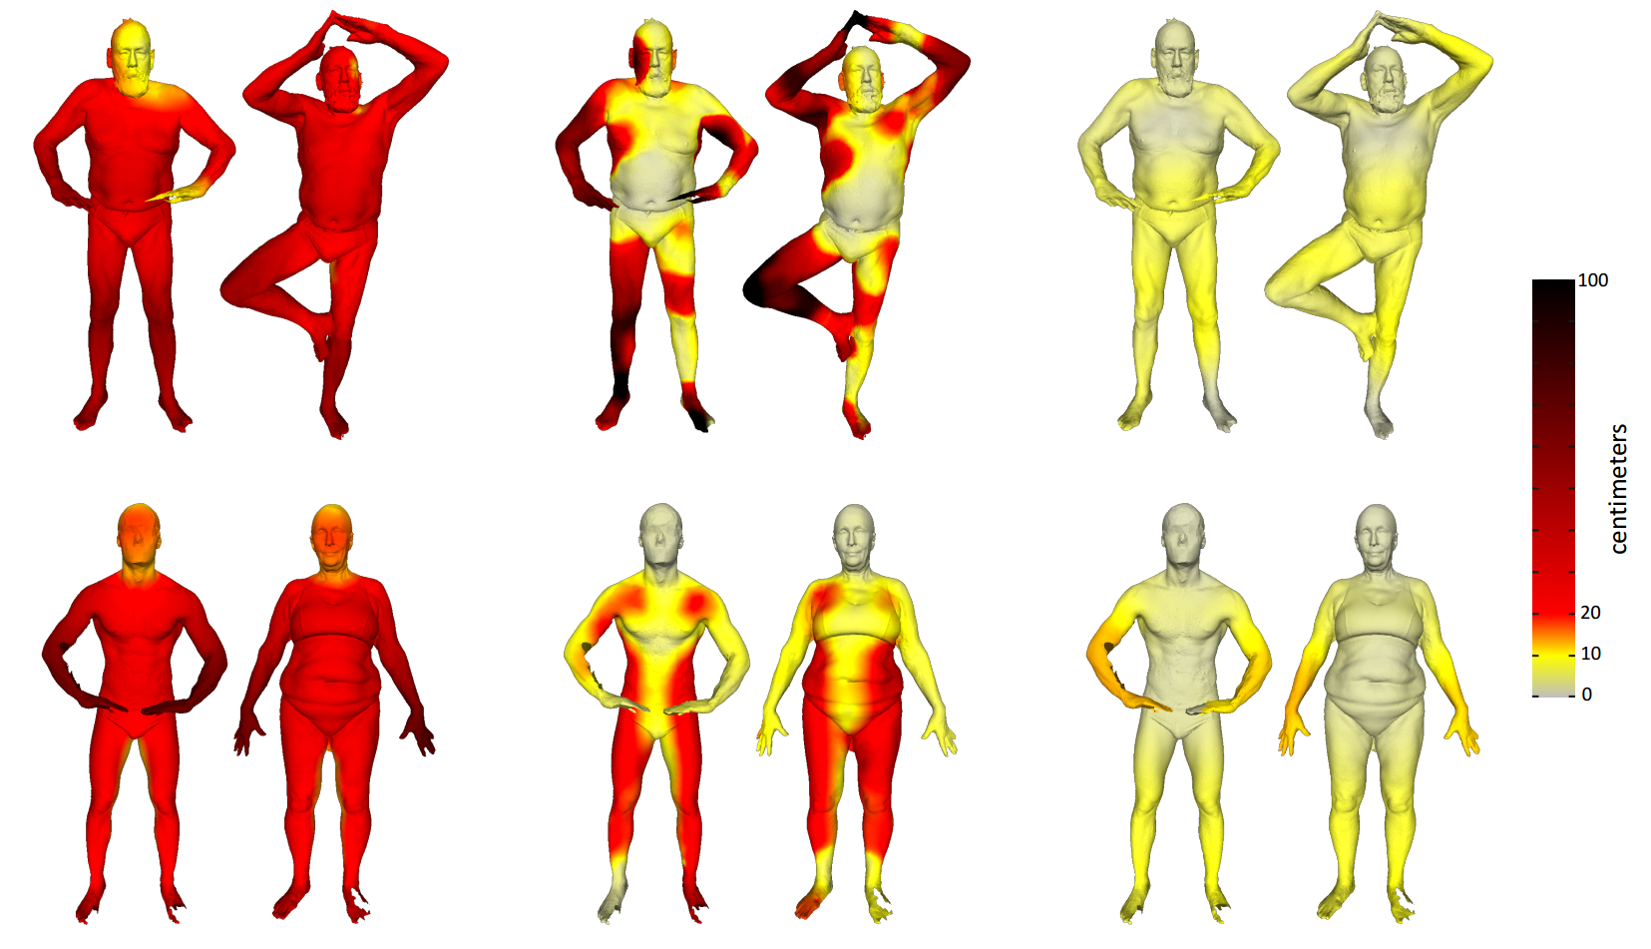
Results
Blended intrinsic maps
[Kim et al. 2011]
Random forest
[Rodola et al. 2014]
Our approach

Slide 17
Summary
Simple but robust
  no descriptors
  convex optimization
  outperforms a large body of prior work by a multiplicative factor
Future work
  partial surface registration
  joint analysis of non-isometric shapes

Slide 18
Questions?
Matlab, C++ code, and data
http://www.stanford.edu/~cqf/convex/

