Slide 1

Cross-modal Steganogarphy:
Hiding Video in Audio
Hyukyrul Yang*, Hao Ouyang*, Vladlen Koltun, and Qifeng Chen
HKUST and Intel

Slide 2
Introduction
Let’s consider an activist who needs to publicize a video record of human rights violations under a repressive regime

Slide 3
Introduction
The regime monitors communication in and out of the country.
How can the activist transmit the video without detection?

Slide 4
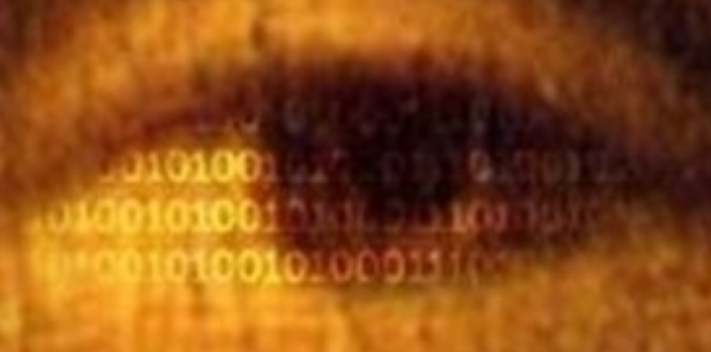
Introduction – Secret Messaging via Steganography
Steganography is the practice of concealing information within media such as images, videos, and audio.

Slide 5
Introduction – Motivation
Steganography is the useful tool to enable concealment of secret content inside publicly transmitted files.
The previous research of steganography has been focused on hiding small size of messages. So, the content file types were limited to images or text messages.
We consider the possibility of hiding video content due to its effectiveness in communication.
We choose audio as the cover medium because audio has higher embedding capacity than text or image files.
“Hiding Video in Audio”

Slide 6
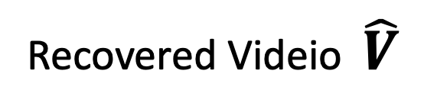
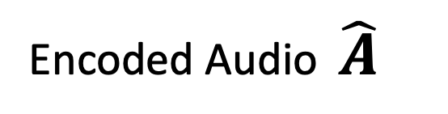
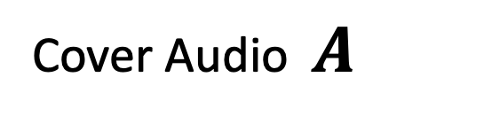
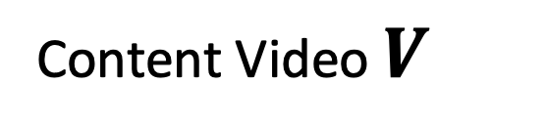
Introduction – Cross-modal Steganography
Content Video $V$
Encoded Audio $\hat{A}$
Recovered Videio $\hat{V}$
Cover Audio $A$
Figure 1. Cross-modal steganography problem visualized in diagram.
“Hiding video in audio" is a form of cross-modal steganography.

Slide 7
Introduction – Research Questions
How can we design the deep learning models which can handle the cross-modal steganography task.
How can we design the efficient way to hide large size of video data into audio file?
How can we achieve high quality encoded audio of which contains the large video data.
How can we recover the content video at high fidelity.

Slide 8
Introduction – Proposed methods
HvCNN
HvF
HvFO
Encoded Audio Fidelity | Low | High | High
Recovered Video Fidelity | High | Low | High
Capacity | Low | High | High
Applied methods | Image Compression Networks 1D Conv UNet | Image Compression Networks WaveGlow | Image Compression Networks WaveGlow Binary Encoder / Decoder Optimization Strategy
Table 1. Comparison on key features of proposed methods.

Slide 9
Introduction – The Goal of this Presentation
HvCNN
HvF
HvFO
Search unexplored challenging cross-modal steganography task.
Cover the entire process to solve cross-modal steganography task
: From HvCNN to HvFO.

Slide 10
Related Works
Related Works
Flow-based Models
Steganography

Slide 11
Related Works – Steganography
Capability
Transparency
Robustness
Figure 2. Steganography trade-off triangle.
Steganography methods can be analyzed in terms of transparency, capacity, and robustness.
Deep networks have recently been applied to steganography, with a strong focus on images.

Slide 12
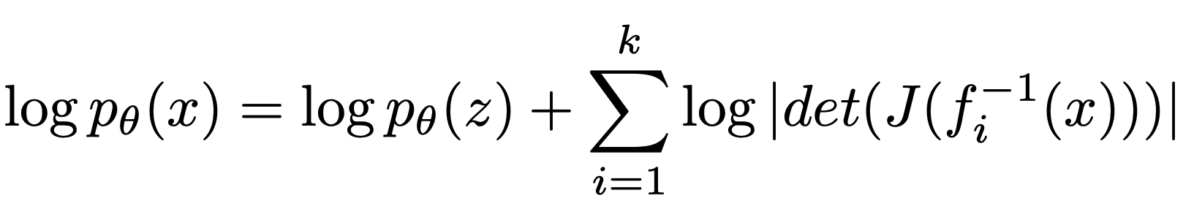
Related Works – Flow-based Generative Models
Figure 3. Visualize the main idea of each generative methods

Slide 13
Preliminaries
Preliminaries
Image Compression Networks
Deep
Steganography
WaveGlow
HvCNN
HvF
HvFO
HvCNN
HvF
HvFO

Slide 14
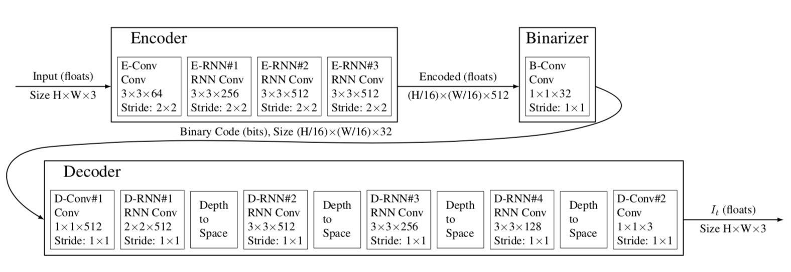
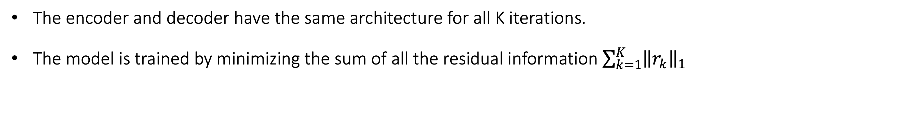
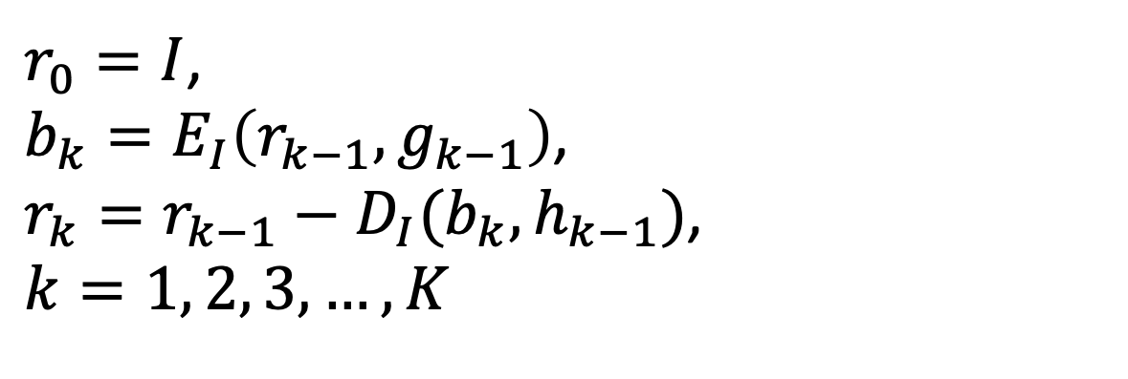
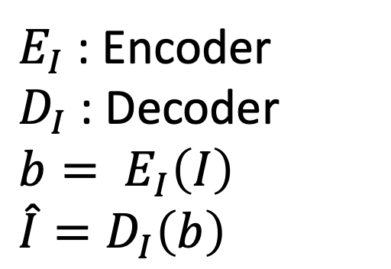
Related Works – Image Compression Networks
(K, 32, H/16, W/16)
Figure 4. Diagram of Image Compression Networks architecture.
$E_{I}$ : Encoder
$D_{I}$ : Decoder
$b= E_{I}\left(I\right)$
$\hat{I}=D_{I}\left(b\right)$
$r_{0}=I$,
$b_{k}=E_{I}\left(r_{k−1}, g_{k−1}\right)$,
$r_{k}=r_{k−1}−D_{I}(b_{k}, h_{k−1})$,
$k=1, 2, 3, …, K$
The encoder and decoder have the same architecture for all K iterations.
The model is trained by minimizing the sum of all the residual information $\sum_{k=1}^{K}{{\left\|r_{k}\right\|}_{1}}$
Full Resolution Image Compression with Recurrent Neural Networks, CVPR 2017 (George Toderici et al. )

Slide 15
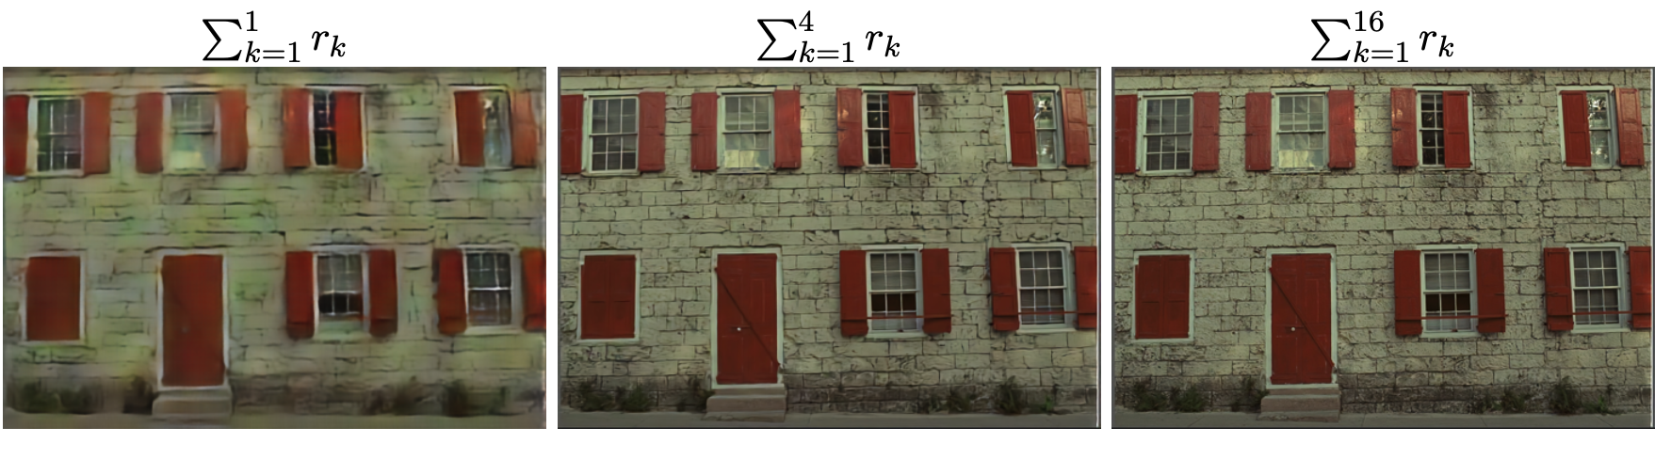
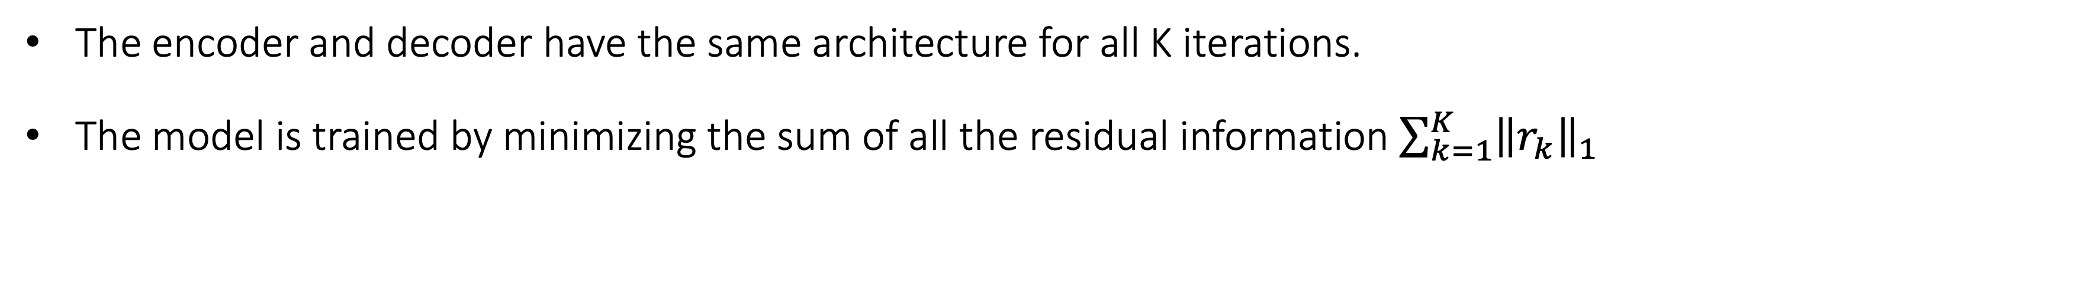
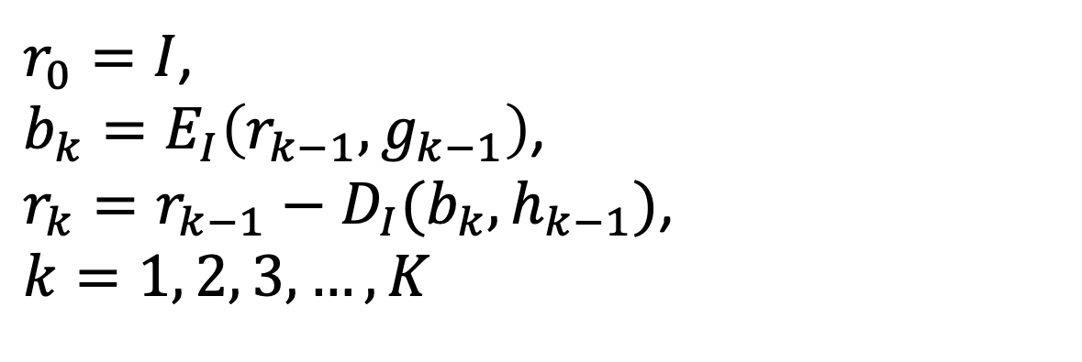
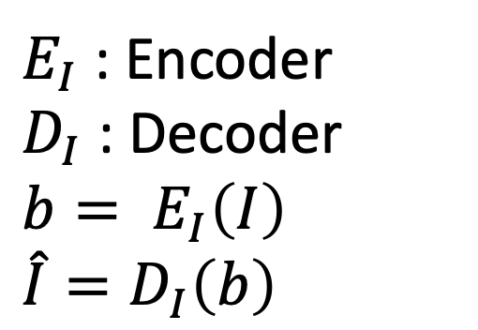
Related Works – Image Compression Networks
K = 1
K = 4
K = 16
Figure 5. Visual comparison of compressed images for different K.
$E_{I}$ : Encoder
$D_{I}$ : Decoder
$b= E_{I}\left(I\right)$
$\hat{I}=D_{I}\left(b\right)$
$r_{0}=I$,
$b_{k}=E_{I}\left(r_{k−1}, g_{k−1}\right)$,
$r_{k}=r_{k−1}−D_{I}(b_{k}, h_{k−1})$,
$k=1, 2, 3, …, K$
The encoder and decoder have the same architecture for all K iterations.
The model is trained by minimizing the sum of all the residual information $\sum_{k=1}^{K}{{\left\|r_{k}\right\|}_{1}}$
Full Resolution Image Compression with Recurrent Neural Networks, CVPR 2017 (George Toderici et al. )

Slide 16

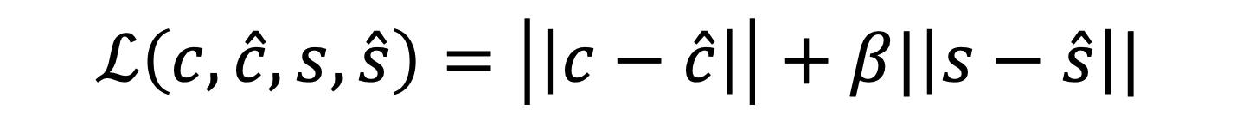

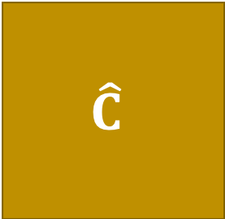
Preliminaries – Deep Steganography
C
Cover
Image
Hiding Network
$$\hat{C}$$
$$\hat{S}$$
Reveal Network
$$S$$
Prep Network
Encoded
Image
Revealed
Image
Secret
Image
$$ℒ\left(c, \hat{c}, s, \hat{s}\right)=\left|\left|c−\hat{c}\right|\right|+β|\left|s−\hat{s}\right||$$
Deep steganography proposed to train an end-to-end deep network for hiding one image inside another.
They use three convolutional neural networks and train with simple reconstruction losses.
Baluja, Shumeet. "Hiding images in plain sight: Deep steganography." Advances in Neural Information Processing Systems. 2017.

Slide 17
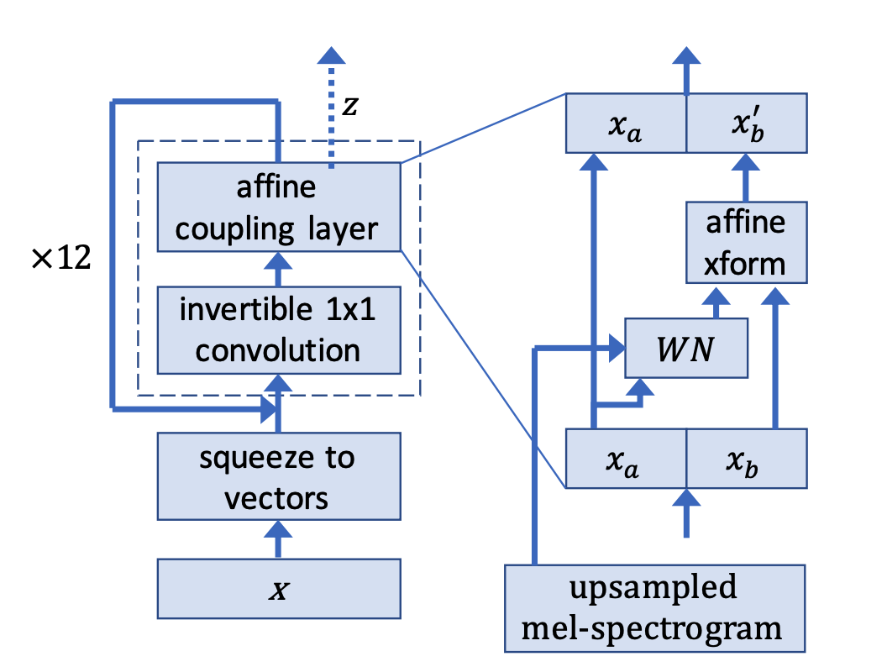
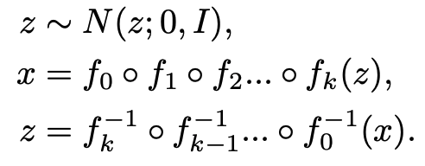
Preliminaries – WaveGlow
The WaveGlow is composed of a sequence of invertible and differentiable layers in a neural network.
WaveGlow: A Flow-based Generative Network for Speech Synthesis

Slide 18
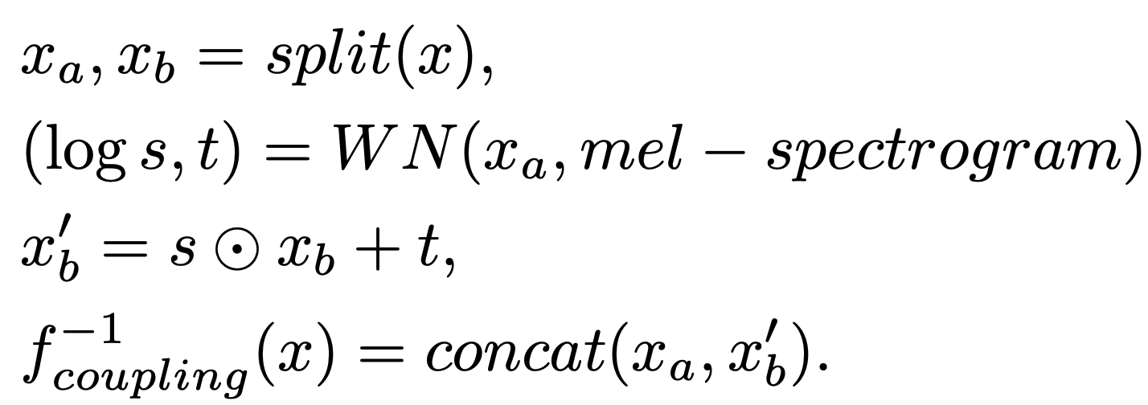
Preliminaries – WaveGlow
The model is trained by minimizing the negative log-likelihood of the data distribution
The mel-spectrogram is given in the affine coupling layer to control the content and tone of the output audio.
WaveGlow: A Flow-based Generative Network for Speech Synthesis

Slide 19
Hiding Via Convolutional Neural Networks – Introduction
There is no baseline for this specific cross-modal steganography task.
Let’s design the method for the cross-modal steganography with the representative baseline in image steganography literature.
Instead of simply borrowing the image steganography method, let's try to maximize performance.

Slide 20



Hiding Via Convolutional Neural Networks – Method : overall architecture
(a) ICN
Hiding stage
Revealing stage
B
B’
V
Encoder
Decoder
V’
(b) Unet Encoder
(c) Unet Decoder
B
$$A$$
$$\hat{A}$$
$$\hat{A}$$
B’
1D Conv Unet
1D Conv Unet

Slide 21



Hiding Via Convolutional Neural Networks – Method : Unet Encoder/Decoder
(b) Unet Encoder
(c) Unet Decoder
B
$$A$$
$$\hat{A}$$
$$\hat{A}$$
B’
1D Conv Unet
1D Conv Unet
24 1D convolutional blocks to process raw audio signals and binary bits.
Each convolutional block has batch normalization module and Leaky ReLU.

Slide 22



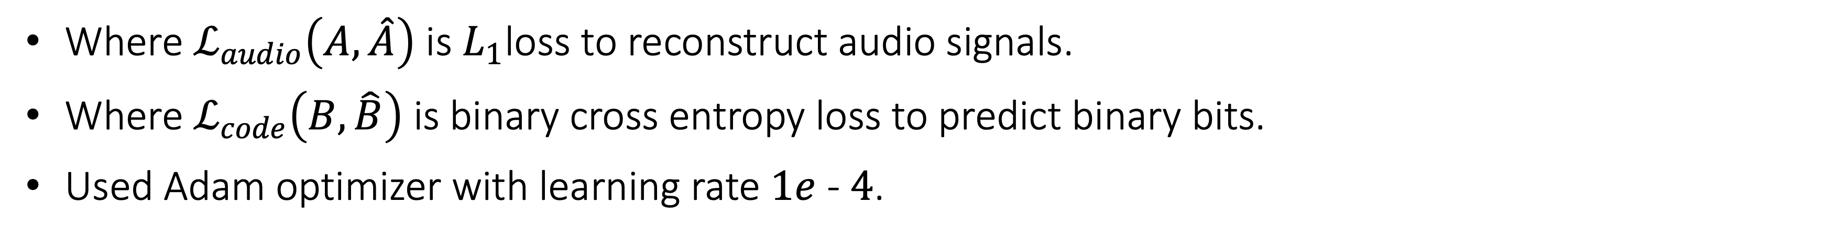




Hiding Via Convolutional Neural Networks – Method : Optimization
(a) ICN
Hiding stage
Revealing stage
$$B$$
$$\hat{B}$$
V
Encoder
Decoder
V’
(b) Unet Encoder
(c) Unet Decoder
$$B$$
$$A$$
$$\hat{A}$$
$$\hat{A}$$
$$\hat{B}$$
1D Conv Unet
1D Conv Unet
$$ℒ\left(A, \hat{A}, B, \hat{B}\right)=ℒ_{audio}\left(A, \hat{A}\right)+ℒ_{code}\left(B, \hat{B}\right)$$
Where $ℒ_{audio}\left(A, \hat{A}\right)$ is $L_{1}$loss to reconstruct audio signals.
Where $ℒ_{code}\left(B, \hat{B}\right)$ is binary cross entropy loss to predict binary bits.
Used Adam optimizer with learning rate $1e$ -$4$.

Slide 23
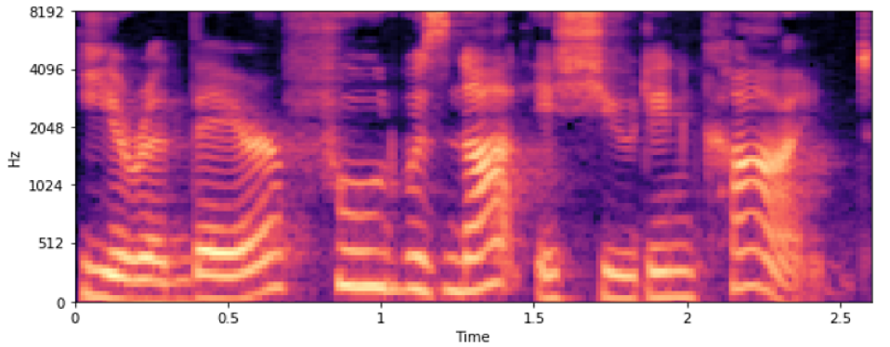
Hiding Via Convolutional Neural Networks – Experiments: Dataset
MS COCO
Object detection dataset.
330,000 images.
Random cropped in 128 x 128 resolution for training.
DAVIS
Video segmentation dataset.
90 videos.
Cropped in 128 x 128 resolution for evaluation.
LJ-Speech
Speech dataset consisting of audio clips of a single speaker reading books.
13,100 audio clips (22,050 Hz)

Slide 24
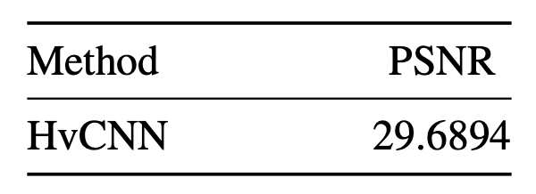
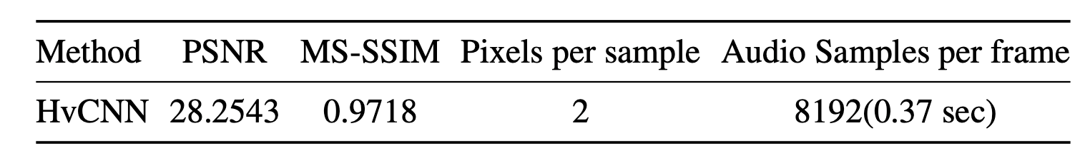
Hiding Via Convolutional Neural Networks – Experiments: Quantitative Analaysis
Table ?. The table of the average PSNR between embedded audio A′ and original audio A of HvCNN on LJ Speech.
Table ?. The table of the average PSNR and MS-SSIM of HvCNN on DAVIS 2017 including metrics to for the capacity.

Slide 25
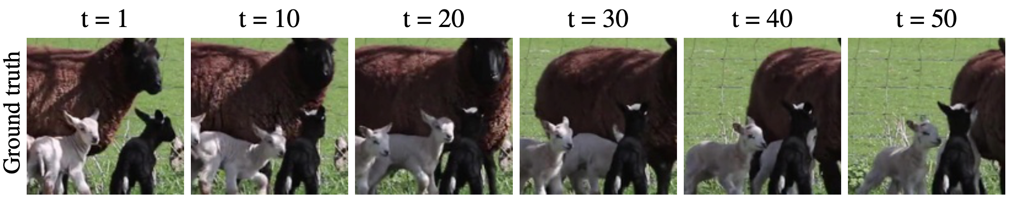
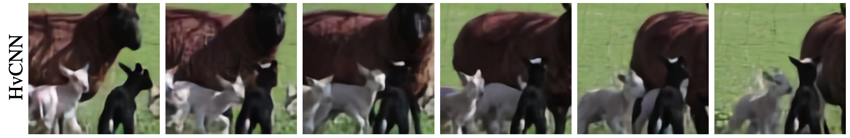
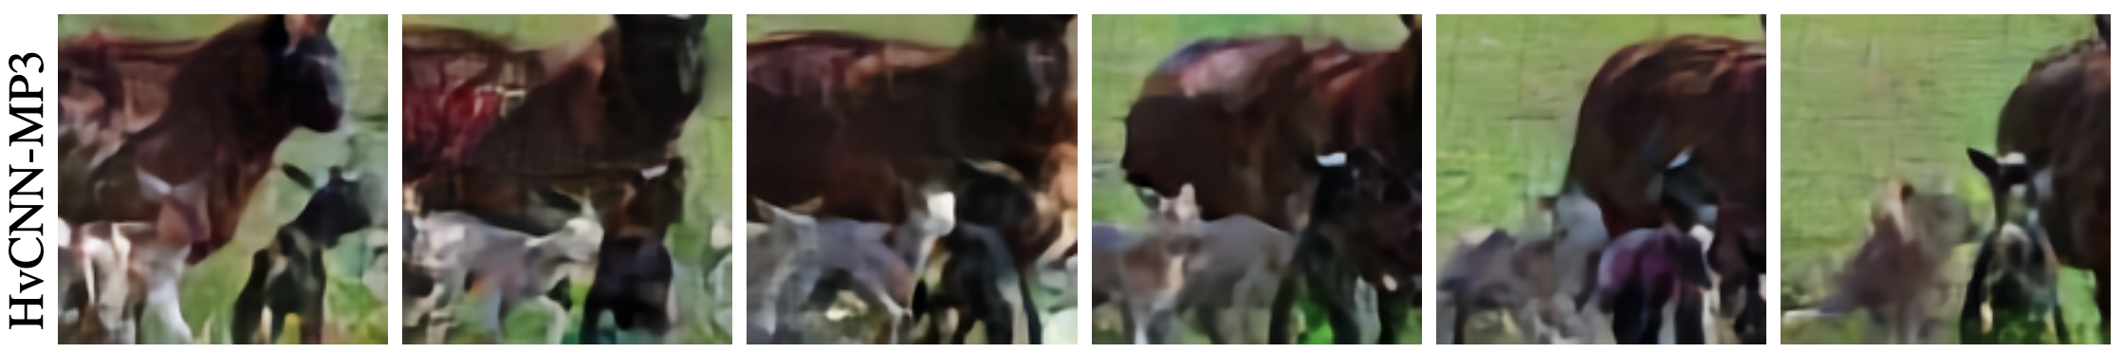

Hiding Via Convolutional Neural Networks – Experiments: Qualitative Comparison
Original audio
Encoded audio

Slide 26
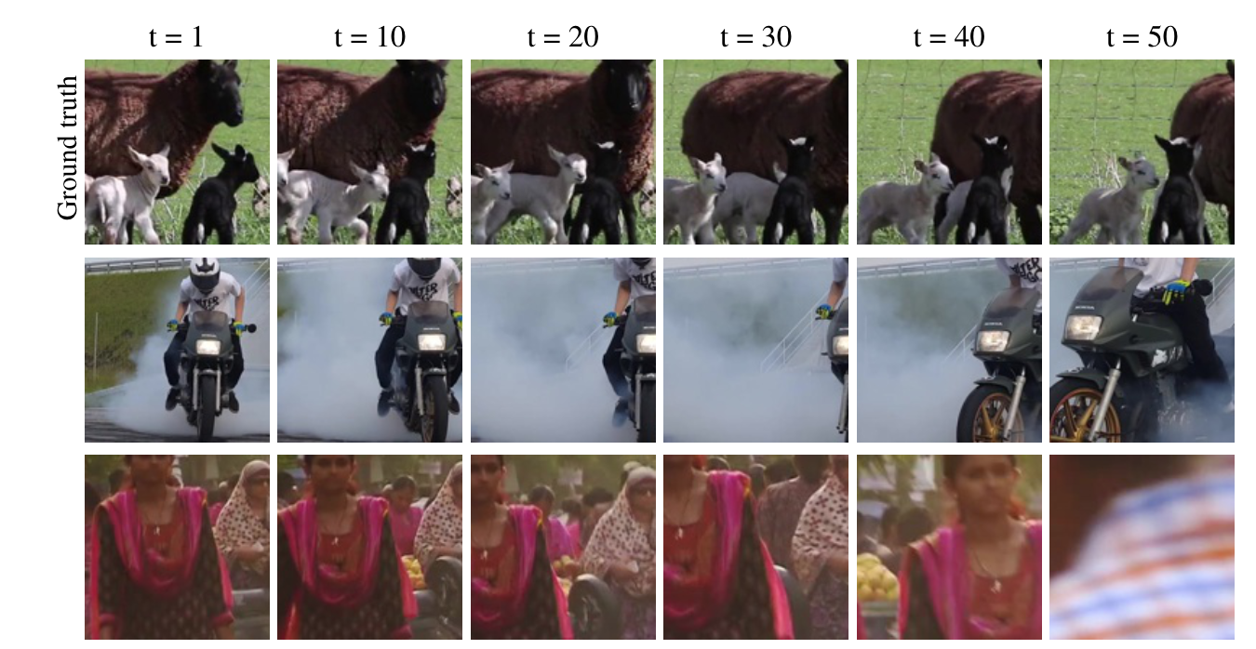
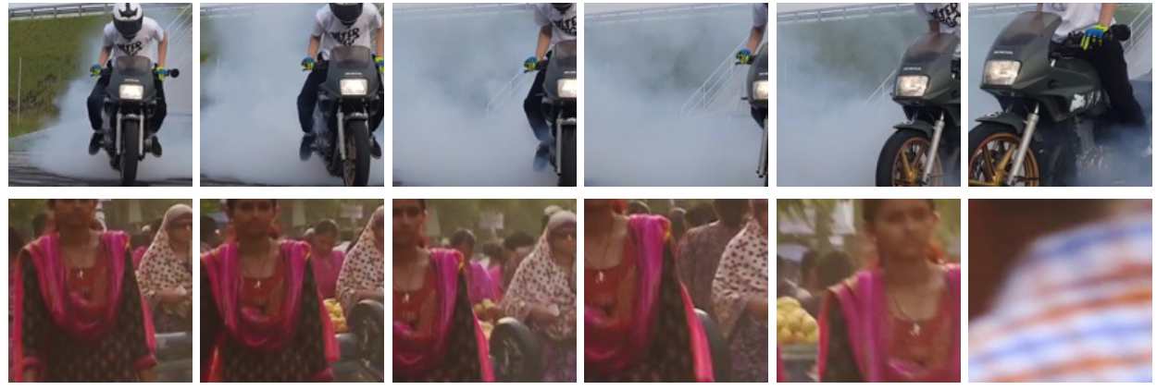
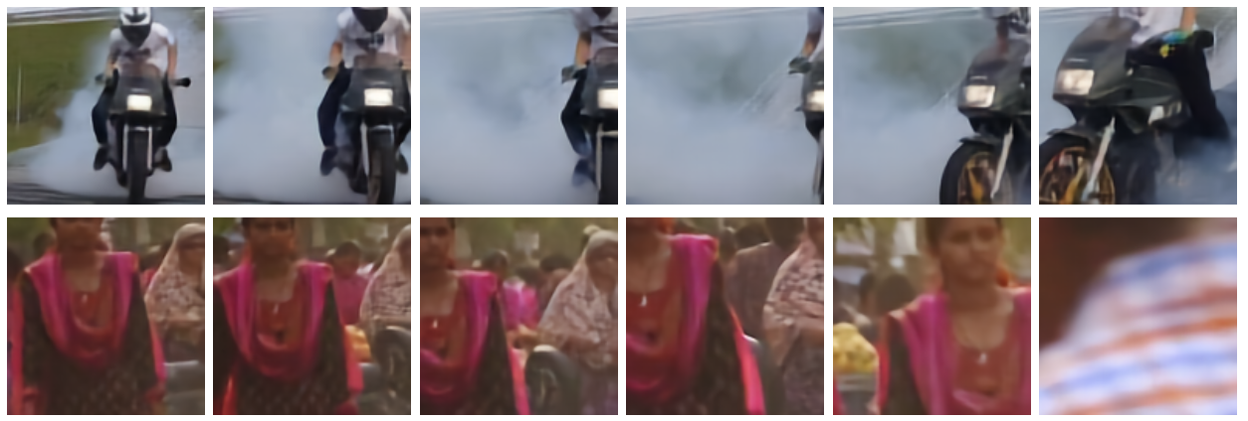

Hiding Via Convolutional Neural Networks – Experiments: Qualitative Comparison

Slide 27
Hiding Via Convolutional Neural Networks – Conclusion
The HvCNN model has significance as a sophisticatedly designed baseline.
Although we introduce the image compression network, the capacity of model was not enough to hide video data.
The HvCNN is enable to recover the secret video properly in terms of the PSNR and MS-SSIM scores.
However, in terms of audio quality, we find that explicit noise is added in embedded audio A.

Slide 28
Hiding via Flow-based Models – Motivation
HvCNN has limitations in that it is difficult to hide a large amount of video and there is clear noise in audio.
There is a need to improve the pipeline that generates audio to solve the noise issue.
WaveGlow

Slide 29





Hiding via Flow-based Models – Method
(a) ICN
Hiding stage
Revealing stage
V
(c) WaveGlow
WaveGlow
Encoded Audio
Encoder
$$\hat{A}$$
$$A$$
C
Mel-spectrogram
C’
Decoder
$$A$$
V’

Slide 30
Hiding via Flow-based Models – Method : ICN with Continuous Bottleneck
(a) ICN
V
Encoder
C
C’
Decoder
V’
Original image compression networks yields binary codes.
ICN for HvF has continuous representation of which range is between -1 and 1.
ICN and WaveGlow are trained separately.

Slide 31
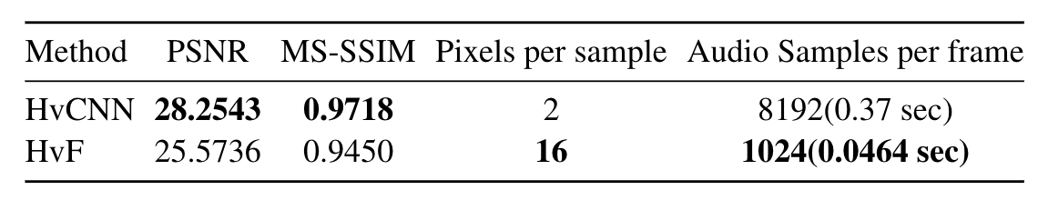
Hiding via Flow-based Models – Experiments: Evaluation on Video Frames
Table ?. Comparison between HvCNN and HvF in terms of video quality
and capacity.
HvF can hide 8 times more video frames than HvCNN.
However, HvF fails to achieve better results than the HvCNN interms of video quality.

Slide 32
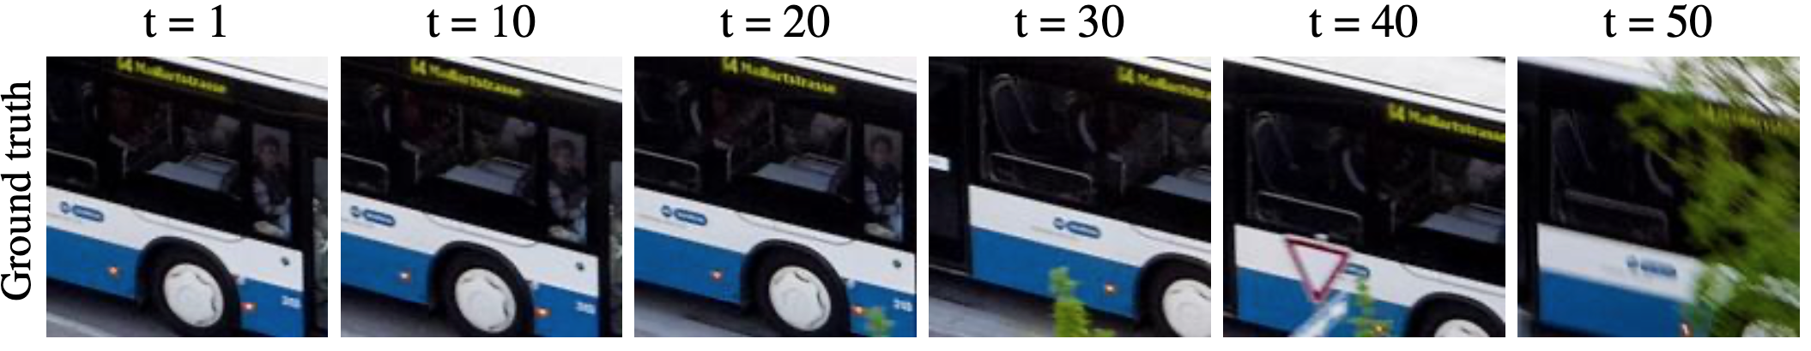

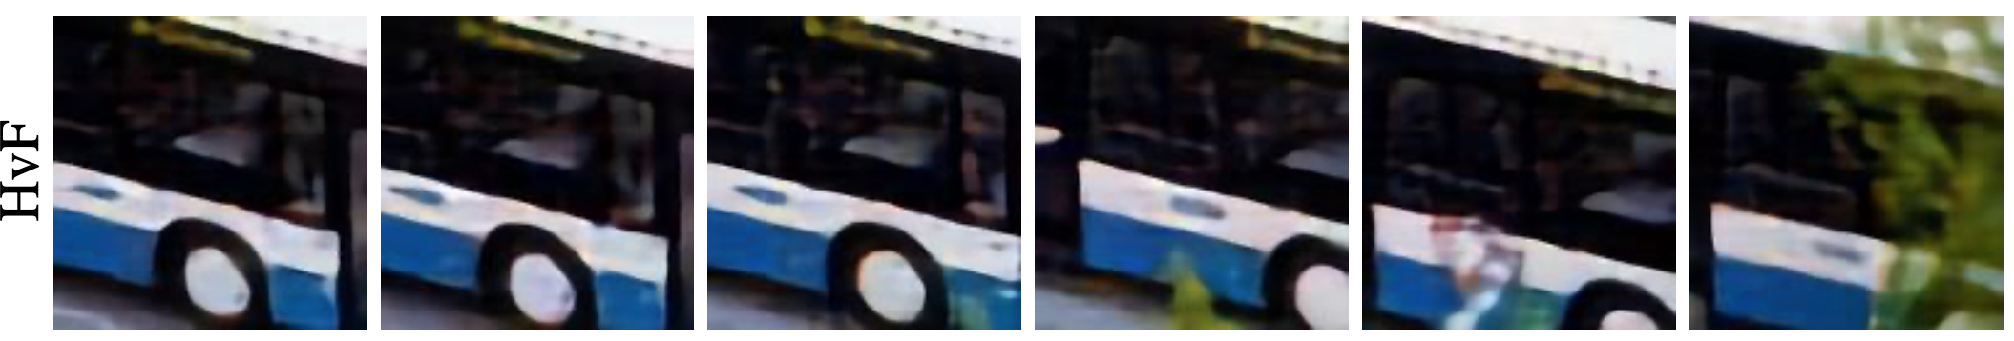
Hiding via Flow-based Models – Experiments: Evaluation on Video Frames

Slide 33
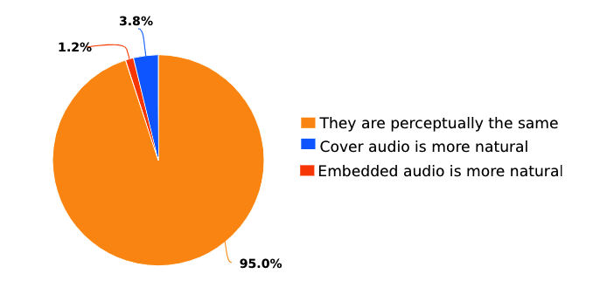
Hiding via Flow-based Models – Experiments: Evaluation on Audio Quality
To be continued
Audio fidelity is almost dependent on WaveGlow performance.
Detailed evaluation will be covered in the next chapter.

Slide 34
Hiding via Flow-based Models – Conclusion
The HvCNN model was successful in video quality, but there was a problem that the embedded audio contains explicit noise.
To solve this problem, HvF introduces a waveglow model and allows us to generate embedded audio with high fidelity.
In addition, the HvF model performs 8 times better in terms of capacity.
However, the HvF model fail to achieve better video quality than the HvCNN model.

Slide 35
Hiding via Flow-based Models with Optimized Strategy – Motivation
HvCNN needs improvement in terms of capacity and audio quality.
HvF has weakness in terms of video quality.
The degradation of video quality on HvF mainly comes from the continuous bottleneck.
We devise the method which enables binary representation in Image Compression Networks while still allows us to leverage WaveGlow.

Slide 36
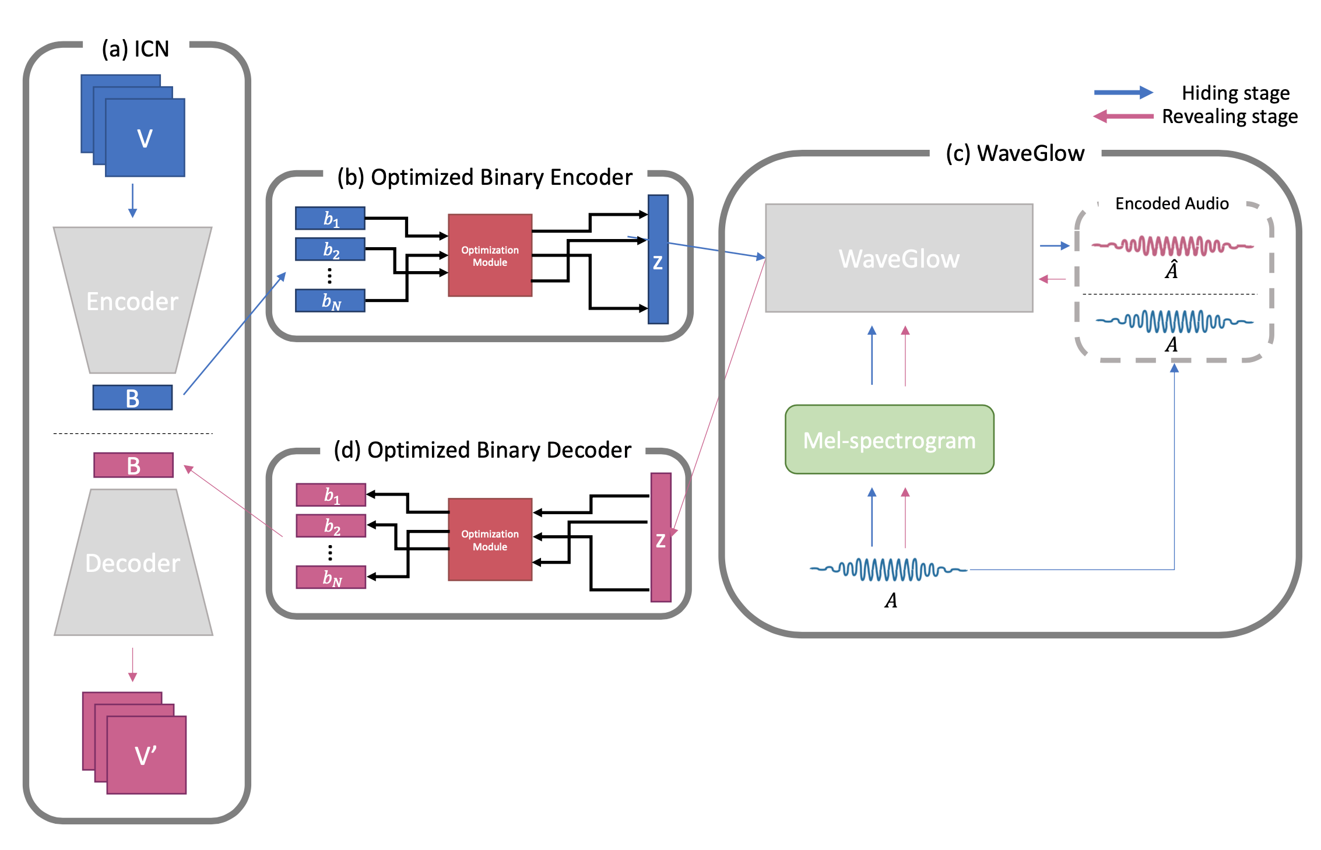
Hiding via Flow-based Models with Optimized Strategy – Method: Overview

Slide 37
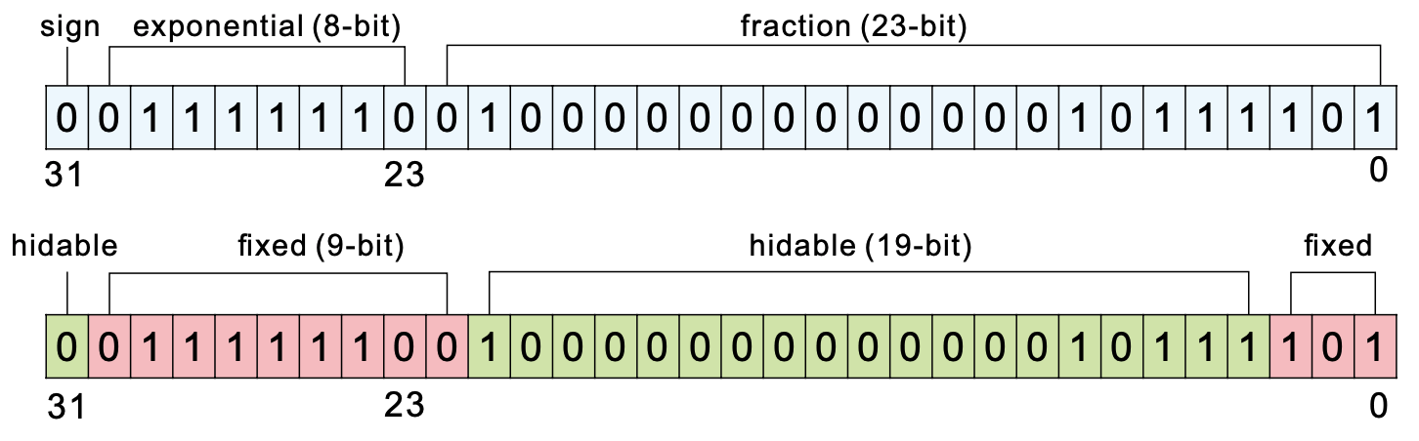
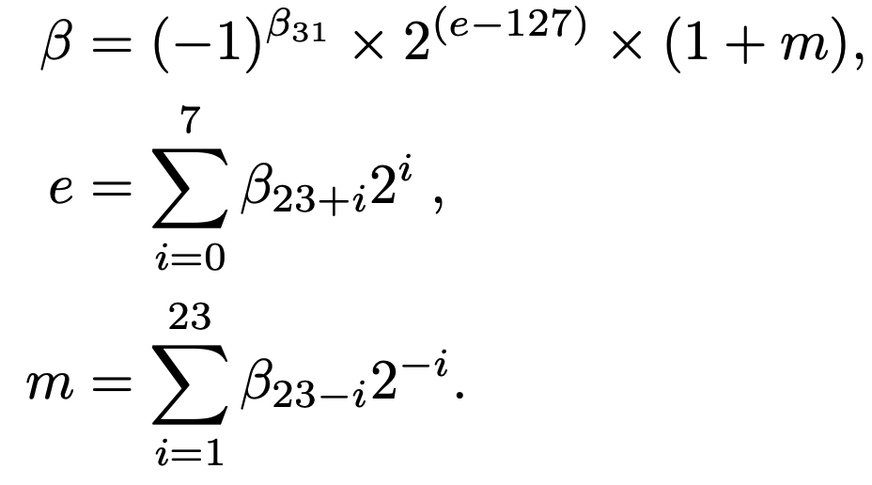
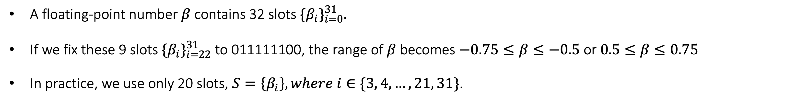
HvFO – Method: Binary Encoder / Decoder
A floating-point number $β$ contains 32 slots ${\{β_{i}\}}_{i=0}^{31}.$
If we fix these 9 slots ${\{β_{i}\}}_{i=22}^{31}$ to 011111100, the range of $β$ becomes $−0.75≤β≤−0.5$ or $0.5≤β≤0.75$
In practice, we use only 20 slots, $S=\left\{β_{i}\right\}, where i∈\{3, 4, …, 21, 31\}$.

Slide 38

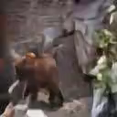
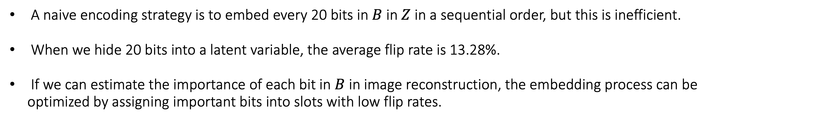
HvFO – Method : Encoding Optimization
Ground Truth
Reconstructed video with naïve binary encoder / decoder
A naive encoding strategy is to embed every 20 bits in $B$ in $Z$ in a sequential order, but this is inefficient.
When we hide 20 bits into a latent variable, the average flip rate is 13.28%.
If we can estimate the importance of each bit in $B$ in image reconstruction, the embedding process can be
optimized by assigning important bits into slots with low flip rates.

Slide 39
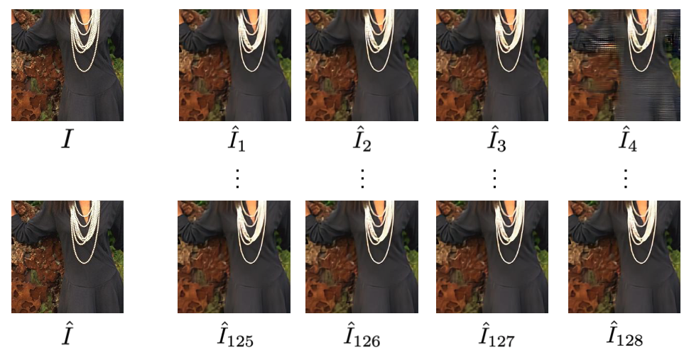
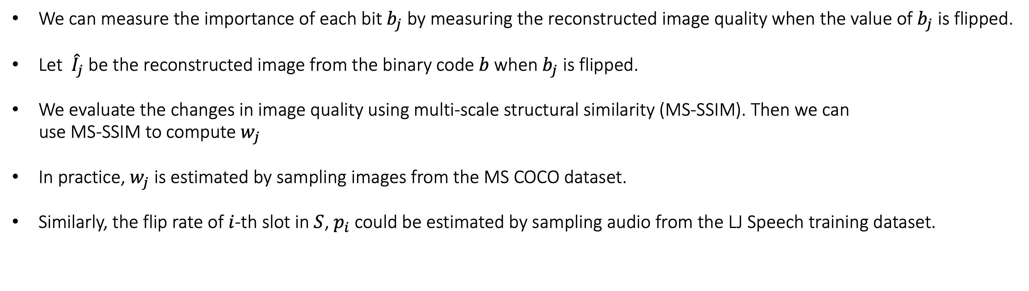
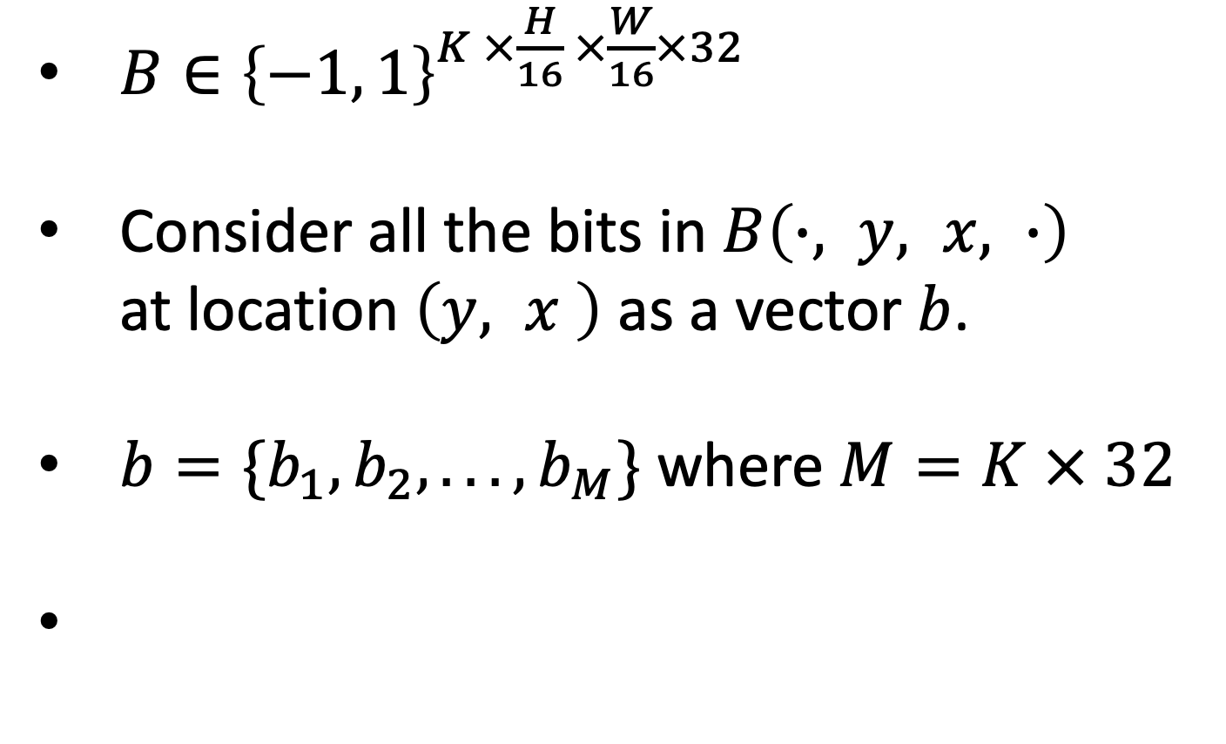
HvFO – Method : Encoding Optimization
$B∈{\left\{−1, 1\right\}}^{K ×\frac{H}{16} ×\frac{W}{16}×32}$
Consider all the bits in $B\left(∙, y, x, ∙\right)$
at location $\left(y, x \right)$ as a vector $b$.
$b=\{b_{1}, b_{2}, . . . , b_{M}\}$ where $M=K × 32$
We can measure the importance of each bit $b_{j}$ by measuring the reconstructed image quality when the value of $b_{j}$ is flipped.
Let ${\hat{I}}_{j}$ be the reconstructed image from the binary code $b$ when $b_{j}$ is flipped.
We evaluate the changes in image quality using multi-scale structural similarity (MS-SSIM). Then we can
use MS-SSIM to compute $w_{j}$
In practice, $w_{j}$ is estimated by sampling images from the MS COCO dataset.
Similarly, the flip rate of $i$-th slot in $S$, $p_{i}$could be estimated by sampling audio from the LJ Speech training dataset.

Slide 40
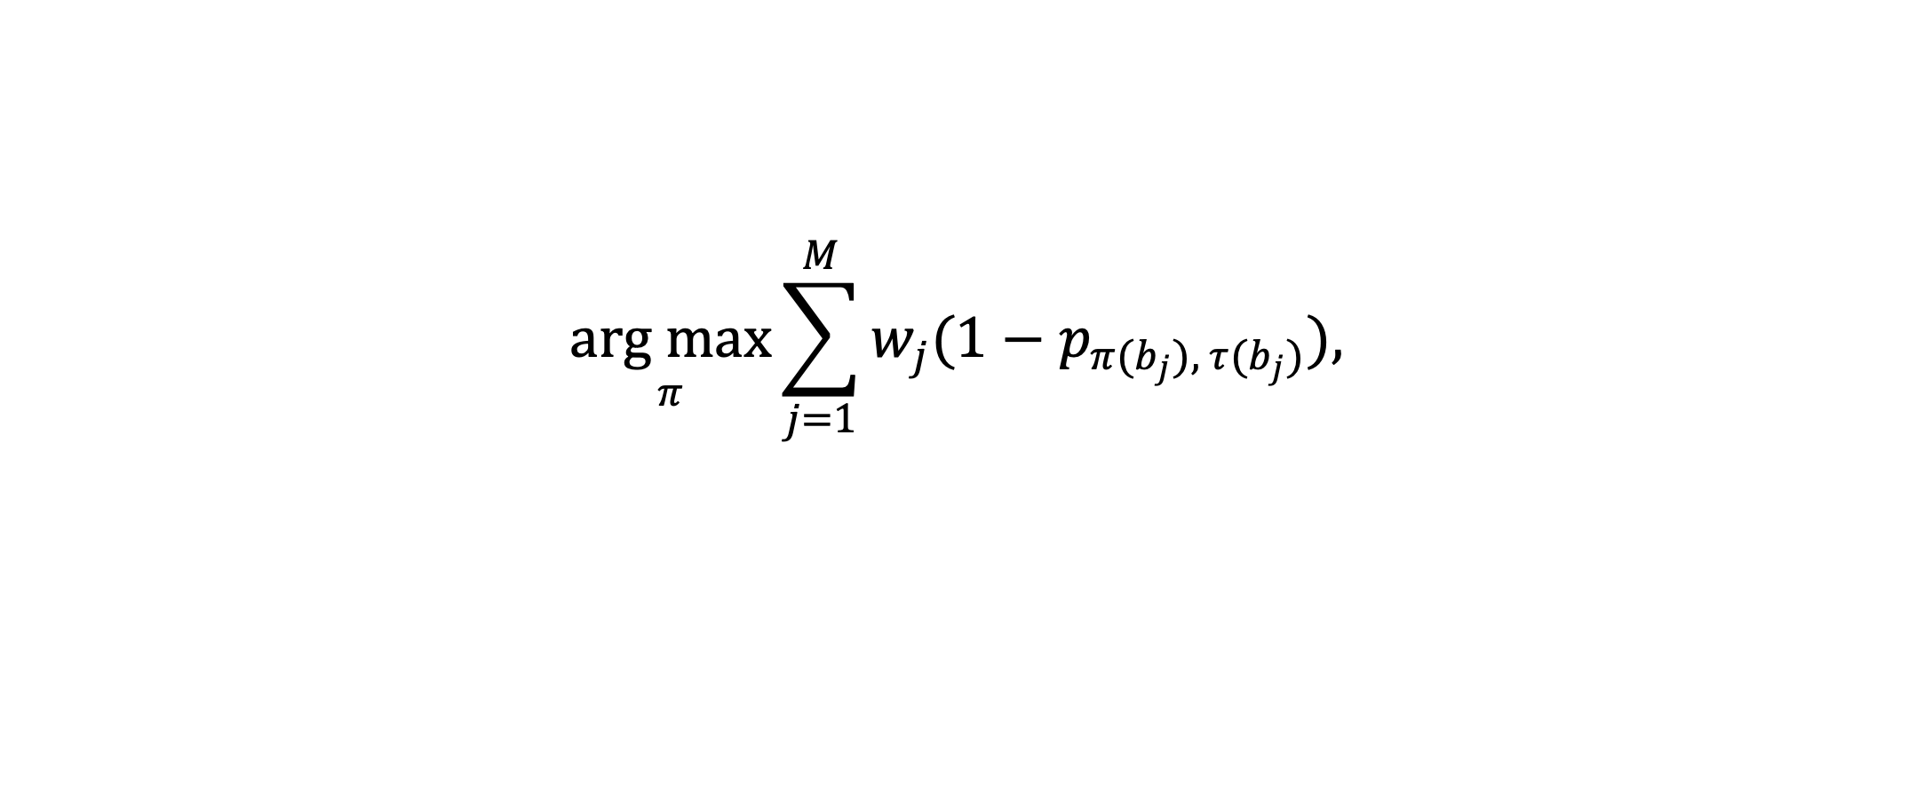
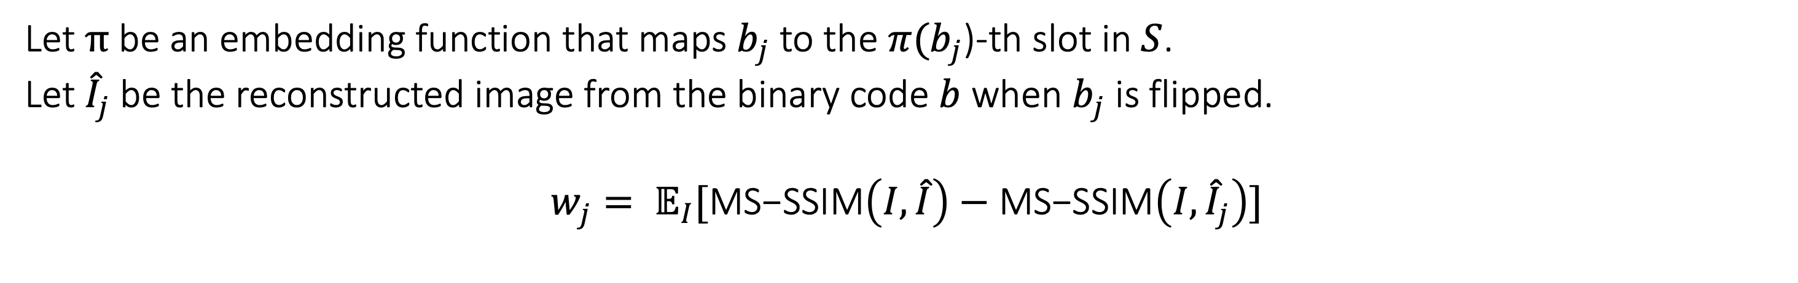
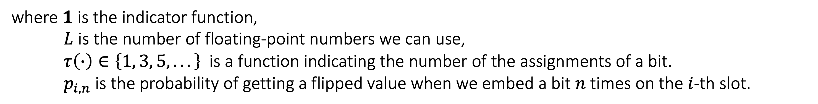
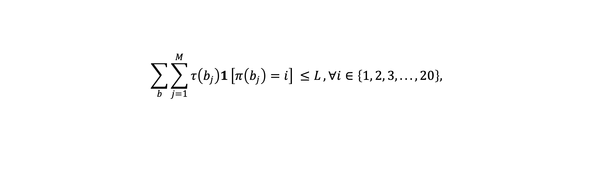
HvFO – Method : Encoding Optimization
Let $π$ be an embedding function that maps $b_{j}$ to the $π(b_{j}$)-th slot in $S$.
Let ${\hat{I}}_{j}$ be the reconstructed image from the binary code $b$ when $b_{j}$ is flipped.
$$w_{j}= 𝔼_{I}[\text{MS}\text{−}\text{SSIM}\left(I, \hat{I}\right)−\text{MS}\text{−}\text{SSIM}\left(I, {\hat{I}}_{j}\right)]$$
$$\underset{π}{arg max}{\sum_{j=1}^{M}{w_{j}(1−p_{π(b_{j}), τ(b_{j})}}), }$$
$$\sum_{b}{\sum_{j=1}^{M}{τ\left(b_{j}\right)1}\left[π\left(b_{j}\right)=i\right] ≤L}, ∀i∈\left\{1, 2, 3, . . . , 20\right\},$$
subject to
where $1$ is the indicator function,
$L$ is the number of floating-point numbers we can use,
$τ\left(∙\right)∈\left\{1, 3, 5, . . .\right\}$ is a function indicating the number of the assignments of a bit.
${ p}_{i, n}$ is the probability of getting a flipped value when we embed a bit $n$ times on the $i$-th slot.

Slide 41
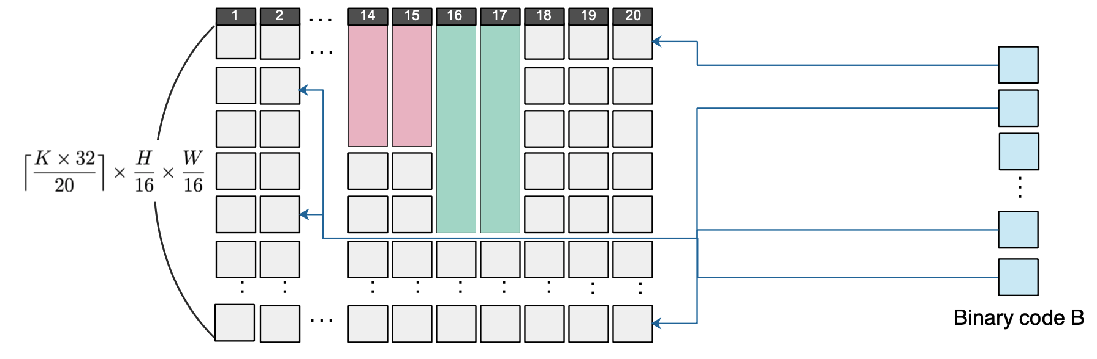
HvFO – Method : Encoding Optimization
To solve this problem, we greedily pick an unassigned bit with the highest importance and assign it an available slot with the lowest flip rate.

Slide 42
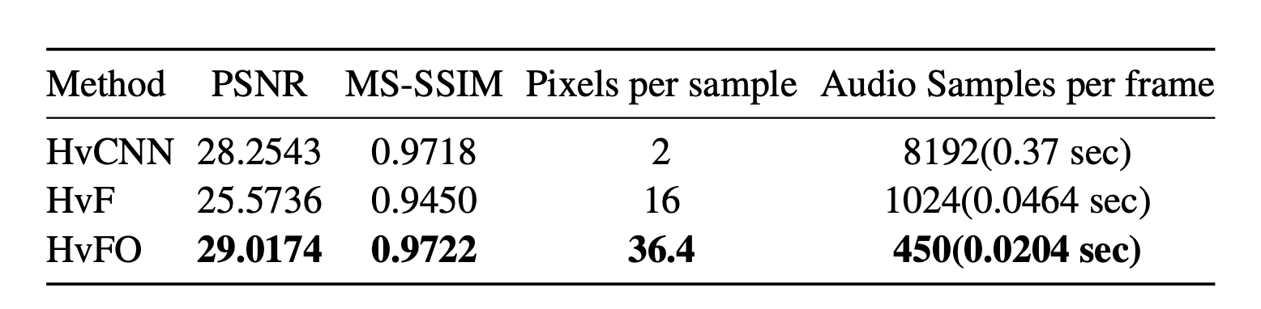
HvFO – Experiments : Evaluation on Video Frames
The video reconstructed by HvFO has much high quality than the baseline methods in terms of PSNR and SSIM.
Our method also has the highest capacity in hiding pixels in audio. Our method can hide a 128 x 128 video in an audio at 49 frames per second.

Slide 43
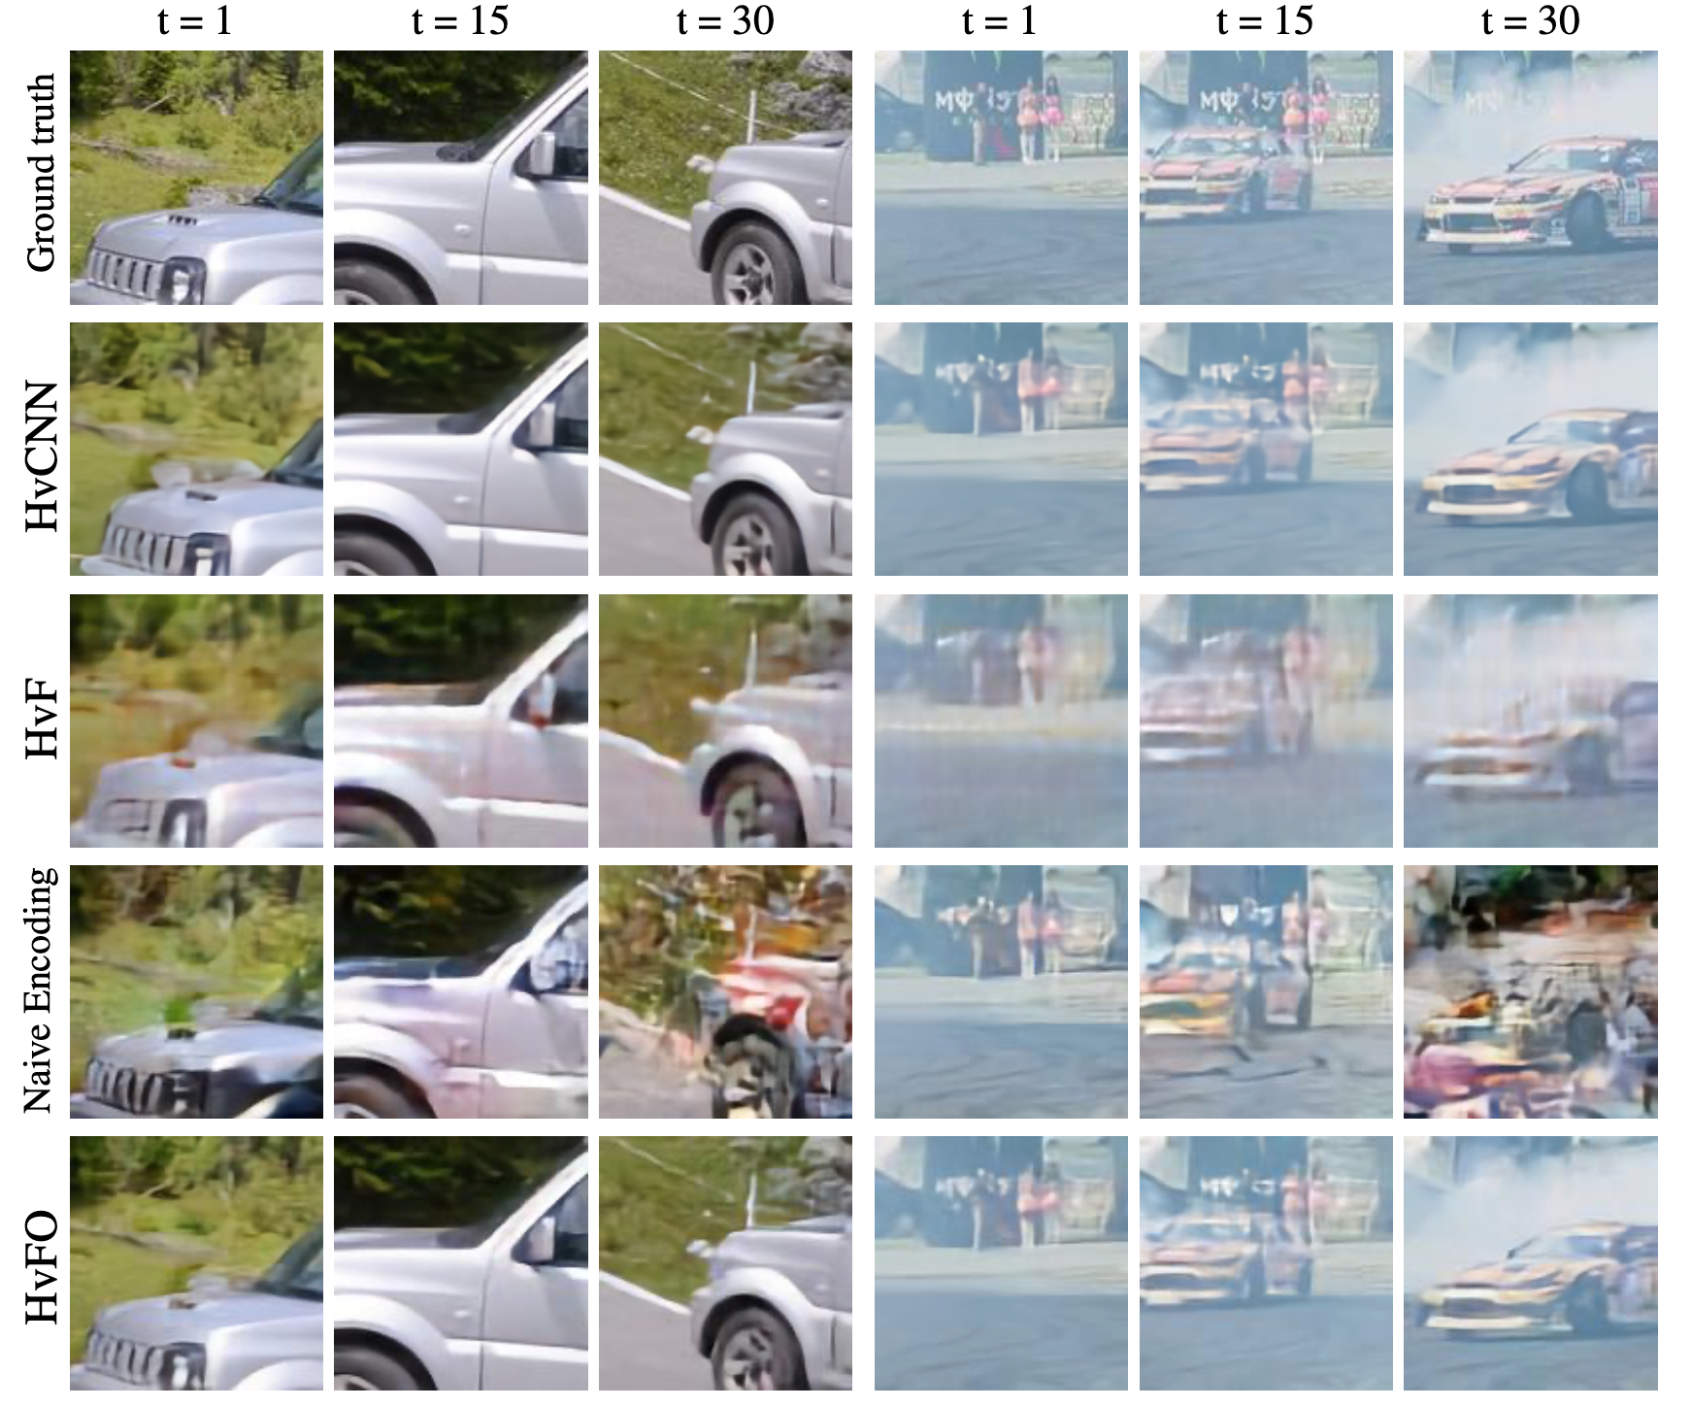
HvFO – Experiments : Evaluation on Video Frames
The video reconstructed by our steganography scheme has much high quality than the baseline methods in terms of PSNR and SSIM.
Our method also has the highest capacity in hiding pixels in audio. Our method can hide a 128 x 128 video in an audio at 49 frames per second.

Slide 44




HvFO – Experiments : Evaluation on Video Frames
Ground truth
HvF
Naïve encoding
HvFO

Slide 45
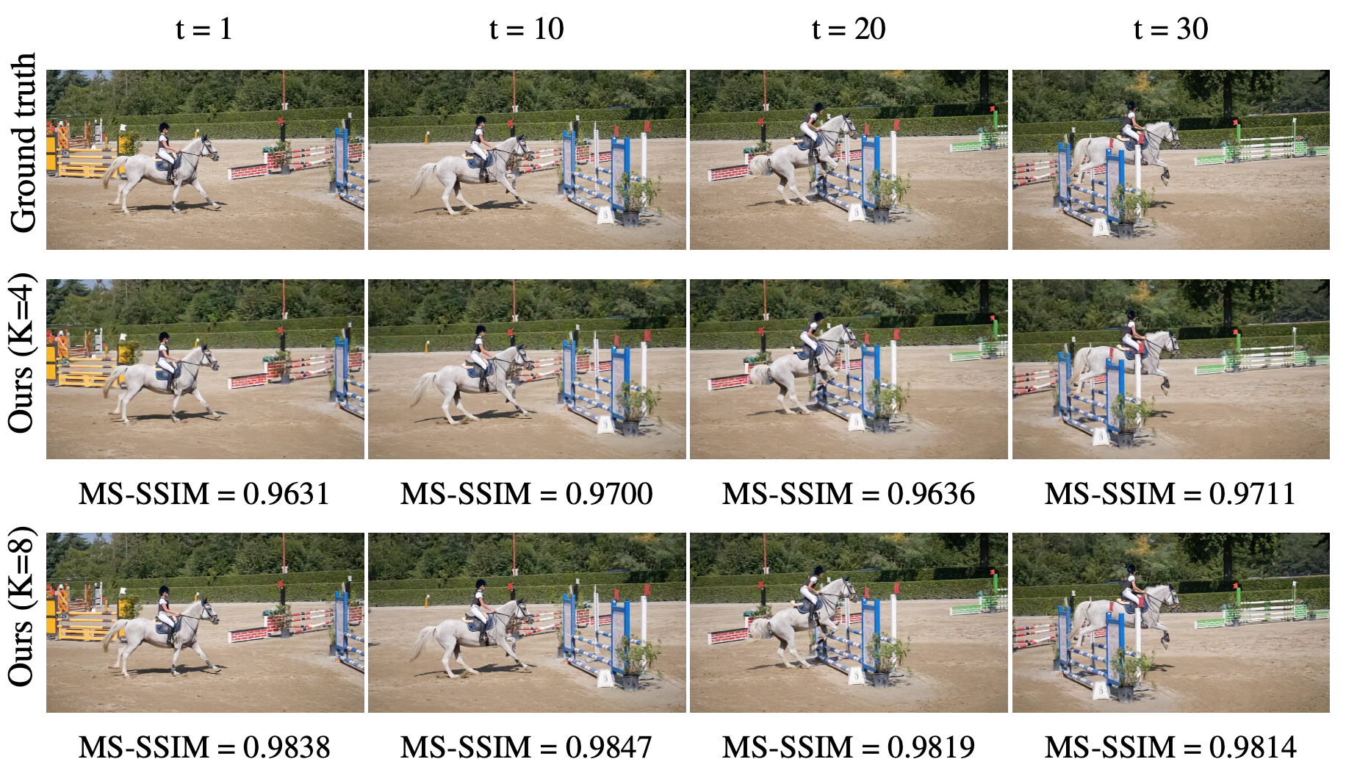
HvFO – Experiments : Evaluation on Video Frames
Our approach can also hide 480×848 video in audio.
A one-second video can be embedded in a 10-second audio signal and has high visual fidelity, with MS-SSIM beyond 0.96 for K = 4

Slide 46

HvFO – Experiments : Evaluation on Audio Fidelity
In the user study, each participant hear the encoded audio and the original cover audio in random order once.
Then the participant needs to choose one of the three options
1. Audio A is more natural
2. Audio B is more natural
3. They are perceptually the same.

Slide 47


HvFO – Experiments : Video & Audio Samples
Ground truth video
Reconstructed video
Ground truth audio
Embedded audio

Slide 48


HvFO – Experiments : Video & Audio Samples
Ground truth video
Reconstructed video
Ground truth audio
Embedded audio

Slide 49
HvFO – Conclusion
We have proposed a novel framework for hiding video in audio combining the strength of image compression networks and invertible generative models.
To further improve the performance, we develop a novel optimized strategy for conversion between binary codes and floating-point latent variables.
Our experiments have shown that our steganography scheme can efficiently conceal video in audio with high video reconstruction quality and perceptually unnoticeable encoded audio.

Slide 50
Conclusion
Since this task has not been actively explored, we have built baselines such as HvCNN and HvF utilizing existing methods.
To overcome limitations of HvCNN and HvF without compromising, we devise HvFO which embeds binary codes directly to continuous numbers in a certain range while optimizing for the robustness to bit flipping.
In the experiments, HvFO has surpassed other methods in all respects of evalua- tion including video quality, embedded audio quality and capacity
However, the research problems remain to be solved to use HvFO in a practical scenario.
We hope that our work can inspire more research on steganography especially using flow-based models.

Slide 51

Appendix – Flow-based models

Slide 52



Appendix – Flow-based models

Slide 53

Appendix – Flow-based models

Slide 54

Appendix – Flow-based models

Slide 55


Appendix – Flow-based models

Slide 56


Appendix – ICN vs JPEG

Slide 57

Appendix – Steganalysis

Slide 58
Appendix – Code shape
All other dimensions are variable
Code shape = (iteration, 32, H/16, W/16)
Some channels may play a more important role in reconstruction

Slide 59

Appendix – Code shape
We flipped all binary codes in each channel.
In the first iteration, 4th and 21th channel were critical to reconstruction.

